Slide 1

MACHINE
INTELLIGENCE
Multi layer Network and Back propagation
K.S.Srinivas
Department of Computer Science and Engineering

Slide 2

MACHINE INTELLIGENCE
Multi layer Network and Back propagation
K.S.Srinivas
Department of Computer Science and Engineering

Slide 3
MACHINE INTELLIGENCE
Multi layer Network
while neurons are really cool,we cannot just use a single neuron to perform complex tasks.
This is the reason our brain has billions of neuron,stacked in layers forming a network .
Similarly ,artificial neurons are arranged in layers.
Each and every layer will be connected in such a way that information is passed from one layer to another.
A typical ANN consists of the following layers:
INPUT LAYER
HIDDEN LAYER
OUTPUT LAYER
Each layer has a collection of neurons and the neurons in one layer interact with all the neurons in other layers.
We use the term nodes or units to represent the neurons in an ANN

Slide 4
MACHINE INTELLIGENCE
INPUT LAYER
The input layer is where we feed in inputs to the network .
The number of units in input layer is the number of inputs we feed to the network.
No computation is performed in the input layer

Slide 5
MACHINE INTELLIGENCE
HIDDEN LAYER
Any layer between the input layer and the output layer is called hidden layers.
It process the input received from input layer.
The hidden layer is responsible for deriving complex relationships between input and output .
That is hidden layer identifies the pattern in the data set.
Main core for learning
There can be n number of hidden layer according to our use case.

Slide 6
MACHINE INTELLIGENCE
OUTPUT LAYER
After processing the input the hidden layer sends its results to the output layer.
As the name suggests the output layer emits output

Slide 7
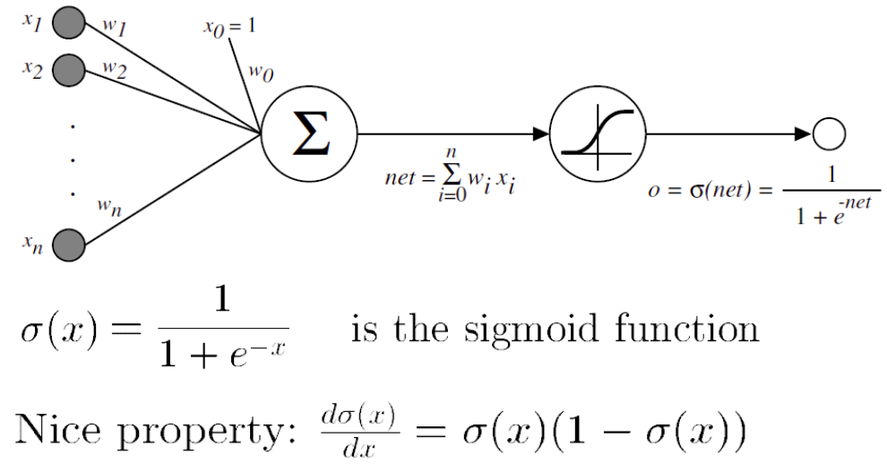
MACHINE INTELLIGENCE
Activation Functions
An activation function,also known as transfer function plays vital role in neural networks.
It is used to introduce a non-linearity in neural networks.
We apply activation function to the inputs which is multiplied by weights and added to bias ,i.e f(z),where z=(inputs*weights)+bias
If we do not apply the activation function,then a neuron simply resembles the linear regression.
ex for an activation function is
Sigmoid Activation Function:
we will learn in deep about activation function in upcoming sessions

Slide 8
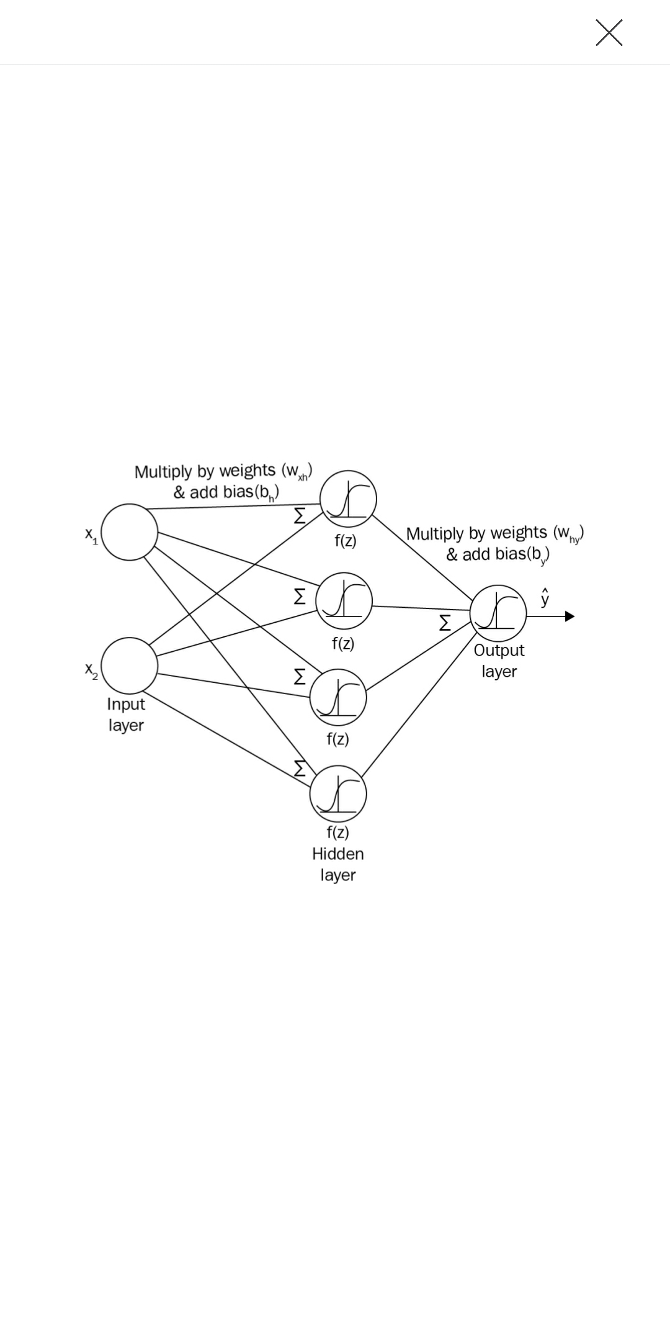
MACHINE INTELLIGENCE
Forward propagation in ANN
the number of layer in an ANN is number of hidden layer +output layer
consider the following two layer neural network
inputs--->2 (x1,x2)
hidden layer units --->>4
output layer units -->>>1
Now the inputs will be multiplied by weights and we add bias and propagate the result value to the hidden layer where the activation function will be applied
Before that we need to initialize the weight matrix.
In real world we don't know which input is more important than the other so that we can weight them accordingly to compute the output.
hence we randomly initialize weights and the bias value.

Slide 9
MACHINE INTELLIGENCE
Forward propagation in ANN
Let the weight and bias between input and the hidden layer be represented as W_{xh} and b_{h} respectively.
let Z1=XW_{xh}+b_{h}
now this is passed through the hidden layer ,we apply activation function here (sigmoid)
ɑ1=σ(z1)
This makes our inputs to the output layer ready
we then multiply this ɑ1 with weight matrix W_{hy} and add with bias b_{y},which is weight matrix and bias between hidden layer and output layer.
we get Z2=ɑ1W_{hy}+b_{y}
which is then passed to sigmoid activation function in the output layer
we get our final output as
ŷ=σ(z2)
Dimension Alert!!
what will be the dimension of the weight matrix
number of units in current layer X number units in next layer

Slide 10
MACHINE INTELLIGENCE
Forward propagation in ANN
This whole process from the input layer to the output layer is known as forward-propagation.
Forward Propagation is cool,but how do we know whether the output generated by the neural network is correct?
The answer is defining a cost function and backpropgating the error

Slide 11
MACHINE INTELLIGENCE
Backward propagation in ANN
Iteratively process a set of training tuples & compare the network's prediction with the actual known target value
For each training tuple, the weights are modified to minimize the loss function between the network's prediction and the actual target value
Modifications are made in the “backwards” direction: from the output layer, through each hidden layer down to the first hidden layer, hence “back propagation”

Slide 12


MACHINE INTELLIGENCE
Backward propagation in ANN
let us first define our loss function
Error as a function the weight vector for a single output unit:
Stochastic approximation:
Error function for multiple output units:

Slide 13
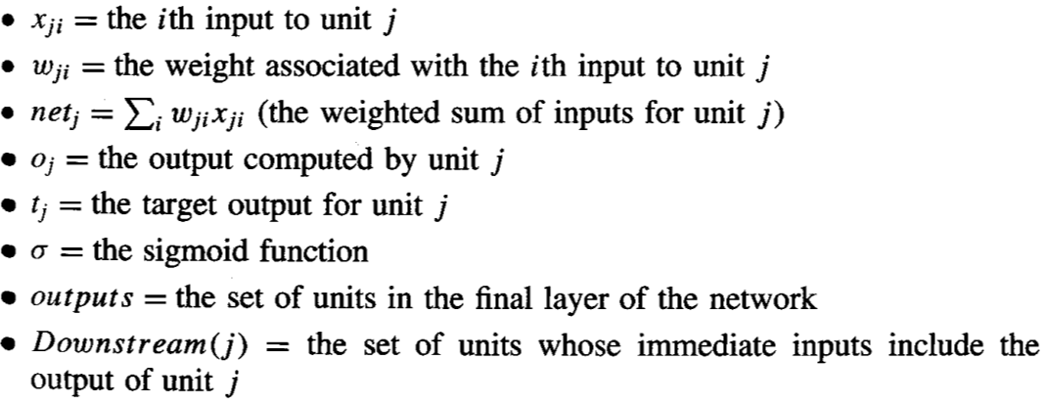
MACHINE INTELLIGENCE
Derivation of Back propagation Rule

Slide 14

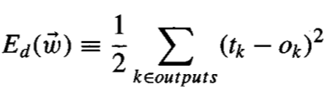



MACHINE INTELLIGENCE
Derivation of Back propagation Rule

Slide 15








MACHINE INTELLIGENCE
Derivation of Back propagation Rule

Slide 16
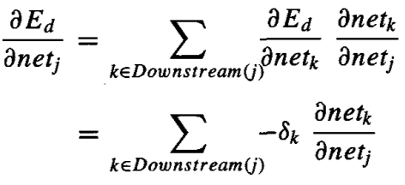





MACHINE INTELLIGENCE
Derivation of Back propagation Rule

Slide 17
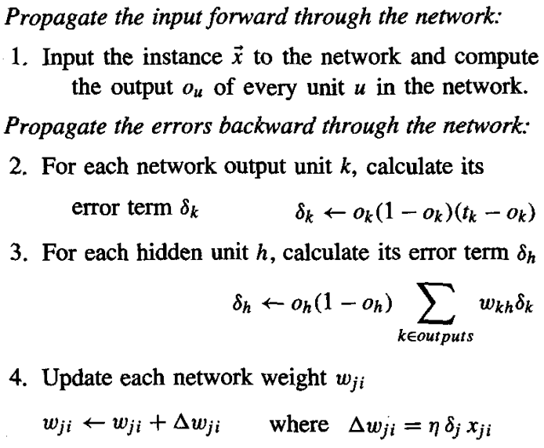
MACHINE INTELLIGENCE
Backward propagation in ANN

Slide 18
MACHINE INTELLIGENCE
Over fitting
Analogous to the Decision Tree case.
With several weights to update and several iterations, the Back propagation Algorithm over fits.
Over fitting occurs because the weights are being tuned to fit idiosyncrasies of the training examples that are not representative of the general distribution of examples.
A solution:
Maintain a different validation set, apart from training set and test set.
Every now and then measure the accuracy over the validation set.
Choose the set of weights that produce the least validation-set error.

Slide 19
THANK YOU
K.S.Srinivas
srinivasks@pes.edu
+91 80 2672 1983 Extn 701

